Slide 1
CSE 510: Applied Deep Learning
Final Project: ResNet architecture for image classification
Team Members:
Nitin Kulkarni: 50337029
Sai Charith: 50320452
Xiao Zhang: 50312346
08/12/2020

Slide 2
Project Description:
Our aim is to build a state of the art ResNet model and compare the results with older models such as AlexNet. The aim is to understand how the different architectures affect the performance parameters such as training time, classification accuracy etc.

Slide 3
Imagenet Dataset

Slide 4
ImageNet is an image database organized according to the WordNet hierarchy (currently only the nouns), in which each node of the hierarchy is depicted by hundreds and thousands of images.
It contains an average of 500 images per class.
ImageNet is an useful resource for researches, educators, and students.

Slide 5
AlexNet

Slide 6
AlexNet was introduced in the year 2012 by Alex et al.
It had 5 convolutional layers, 2 fully connected layers and an output layer.
It used ReLU activation function.
It used batch normalization layer which isn’t common anymore.
The total number of parameters in AlexNet are around 30 million.

Slide 7
RESNET

Slide 8
ResNet was introduced in the year 2015 by He et al.
They came up with a simple yet innovative idea of using residual blocks to overcome the vanishing gradient problem.
In residual block, we add a shortcut from input to the output of the block.
If the weights and bias become zero due to the vanishing gradient problem, we still have the input and this will decrease the training time.
There were different structures of ResNet introduced

Slide 9
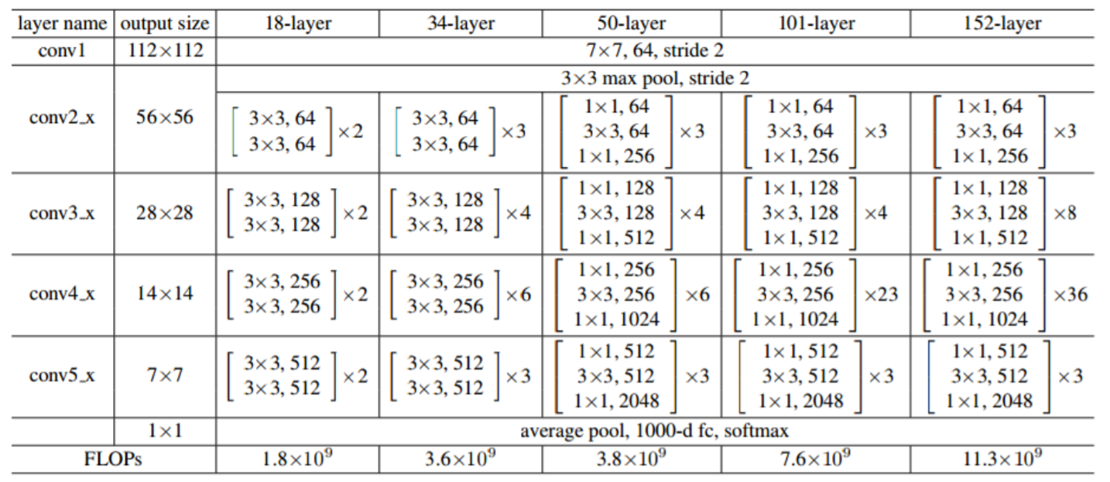
We implemented the 34 layer and the 50 layer ResNet. We are still testing the 18 layer ResNet with regularization.

Slide 10
Implementation
We took 30 classes from the ImageNet dataset with 1000 images each.
We built AlexNet to classify the ImageNet dataset.
We have built ResNet -34 state of the art model to classify the ImageNet dataset.
We compared the results from AlexNet and ResNet and found that ResNet performed better.

Slide 11
Demo

Slide 12
results

Slide 13
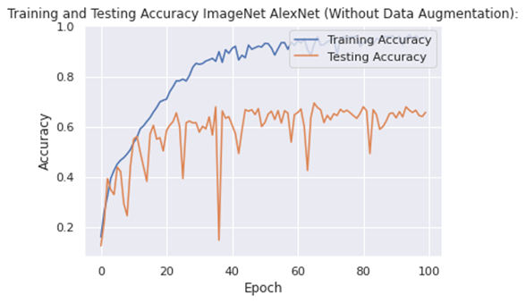
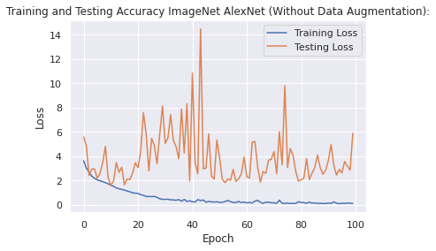
AlexNet

Slide 14
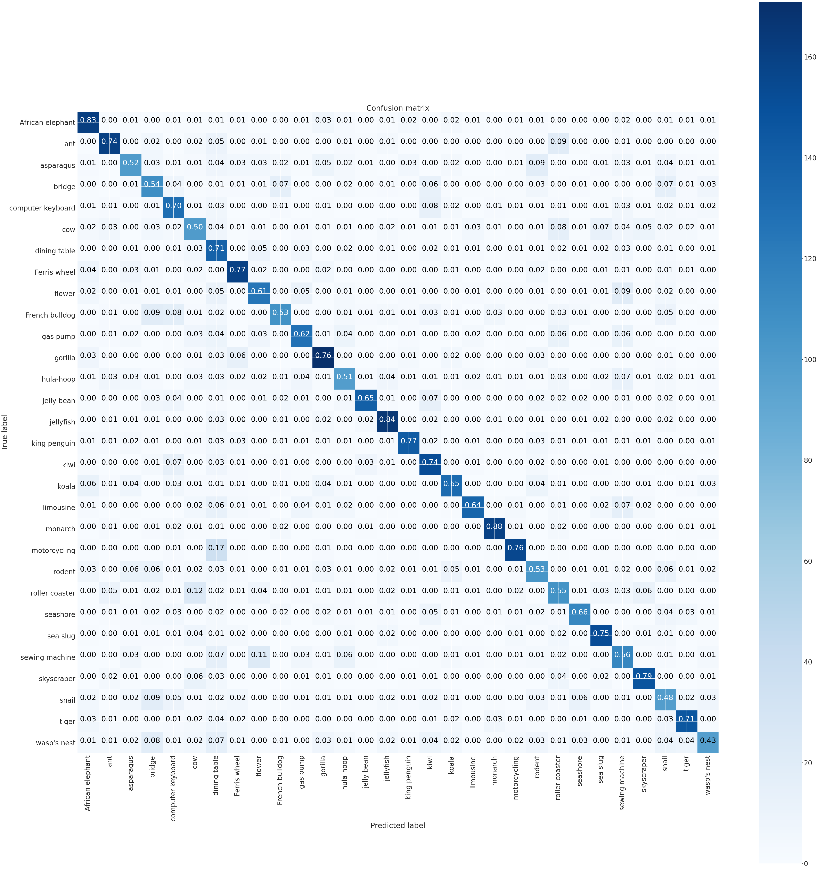

Slide 15
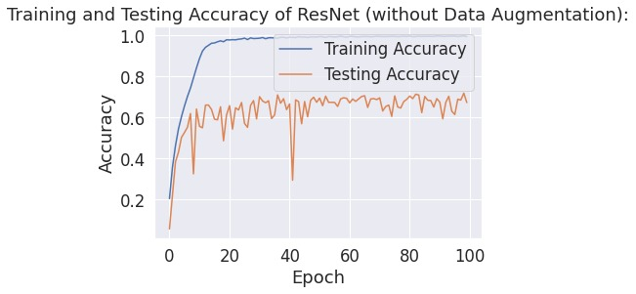
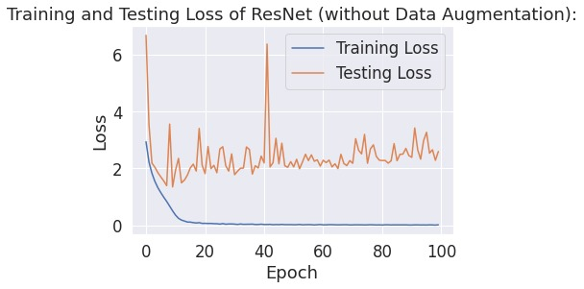
ResNet-34

Slide 16
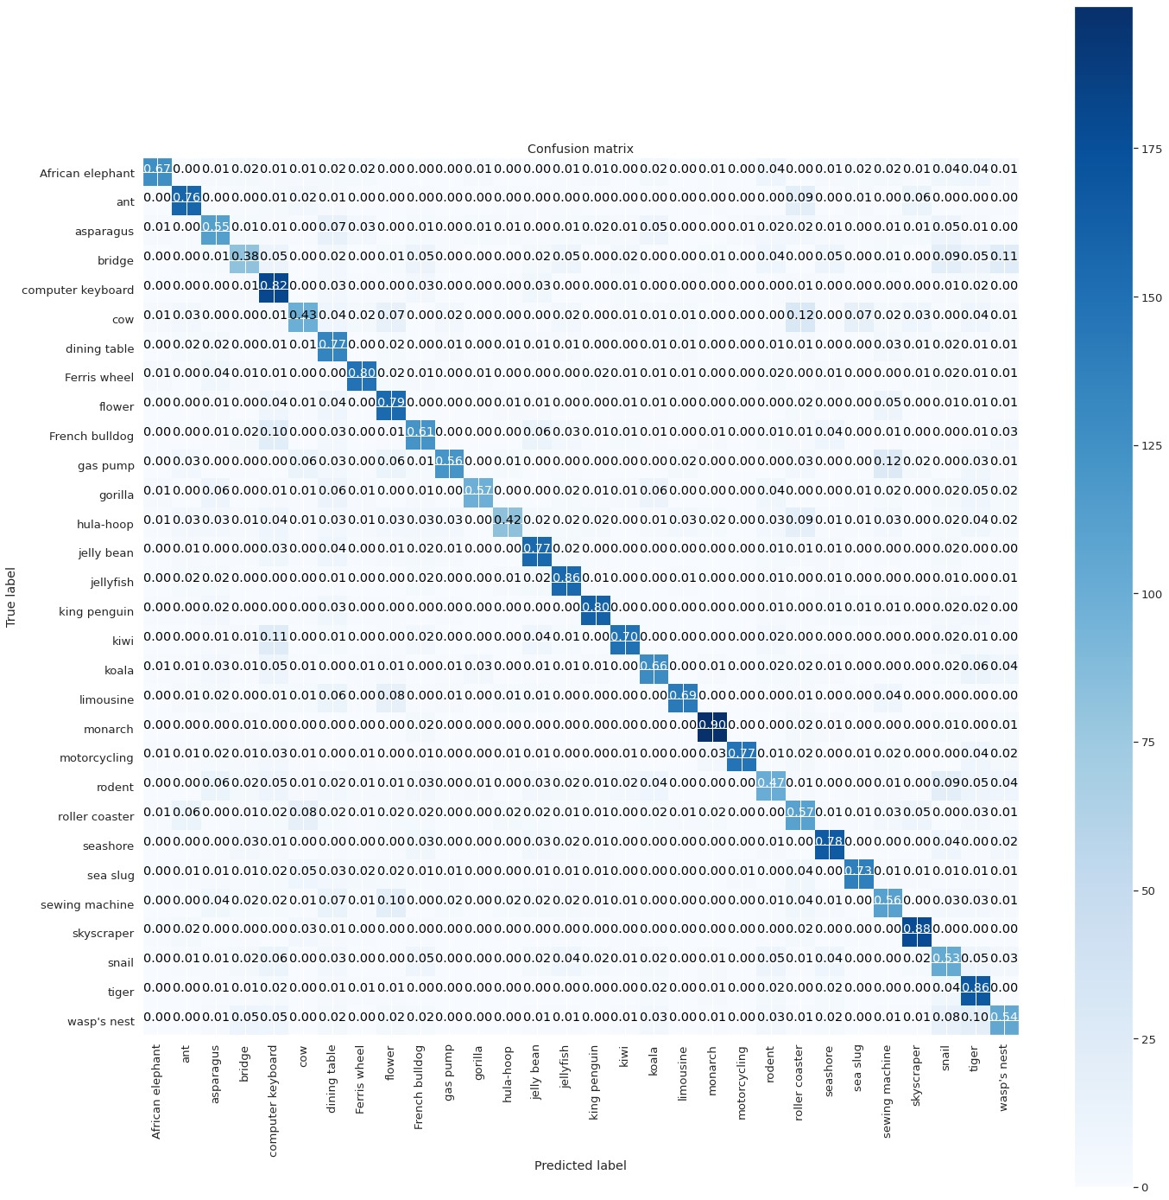

Slide 17
ResNet 50
Epoch 100:
loss: 5.3707e-04
accuracy: 1.0000
Validation loss: 2.4976
Validation accuracy: 0.6288

Slide 18
Summary
As we observed the 34 layer ResNet performs better than AlexNet.
50 layer ResNet overfits and performs worse than the 34 layer Resnet. We believe if we are able to get more images per class the performance may improve.
Deep CNN models take a huge time to train.
We can now focus on building efficient networks that can un on mobile devices.

Slide 19
Thank You Any questions?

